Slide 1


Adaptive Multi-Stage Behavioural Progression Architecture for Early Detection of SIP Toll Fraud
K.M.U.P. Kosgoda
MS24913188
MSc in Information Systems
Sri Lanka Institute of Information Technology
Supervisor: Dr. Nimal Ratnayake
Notes:
My research topic is Adaptive Multi-Stage Behavioural Progression Architecture for Early Detection of SIP Toll Fraud.
This research focuses on VoIP security, especially SIP-based toll fraud. The main idea is to detect suspicious SIP behaviour before it reaches the final fraud burst stage.
In the previous proposal stage, I mainly presented the research problem, gap, conceptual framework, and methodology. In this progress presentation, I will briefly remind the background and then mainly focus on the practical progress I have completed so far.
I will explain the lab setup, the normal SIP behaviour baseline, the simulated SIP traffic generation using SIPp, and how these outputs will be used for feature extraction, stage detection, risk scoring, and validation.

Slide 2

Introduction
SIP controls registration and call setup in VoIP networks.
Suspicious activity can progress through probing, credential failures and call attempts.
An early review alert can support investigation before outbound calling.
Independent permission context helps interpret a suspicious recovery.
Research focus: review suspicious progression before outbound calling
Notes:
SIP provides registration and call-signalling mechanisms. My research asks what evidence can support a review before an outbound call. The lab observes behaviour and checks an independent permission record. An alert alone cannot identify the human operator. Source: RFC 3261, https://www.rfc-editor.org/info/rfc3261/.

Slide 3
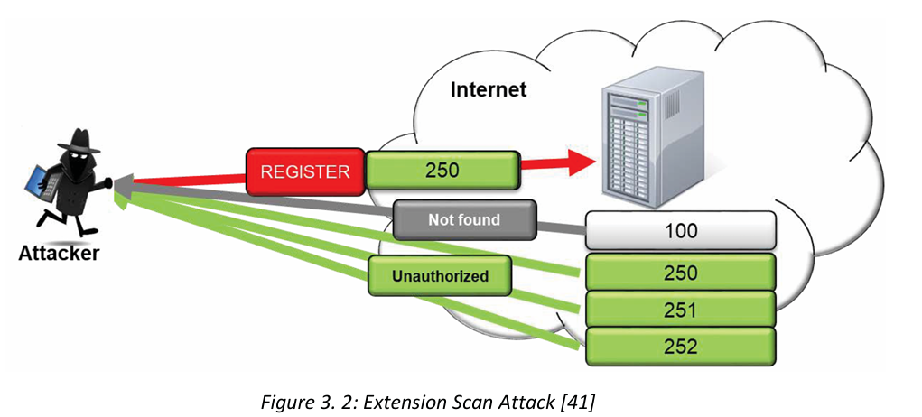
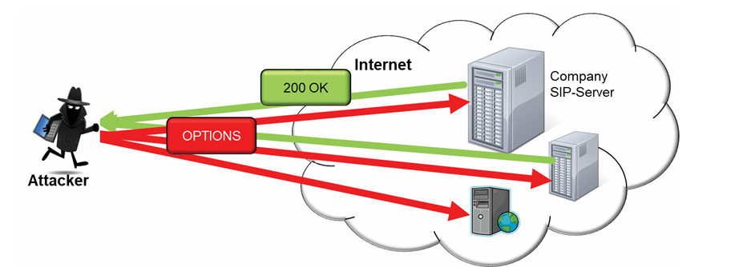


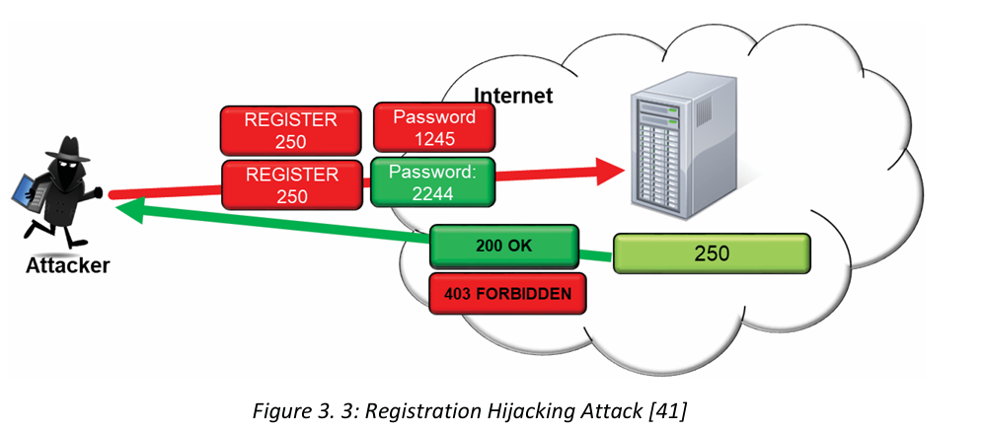
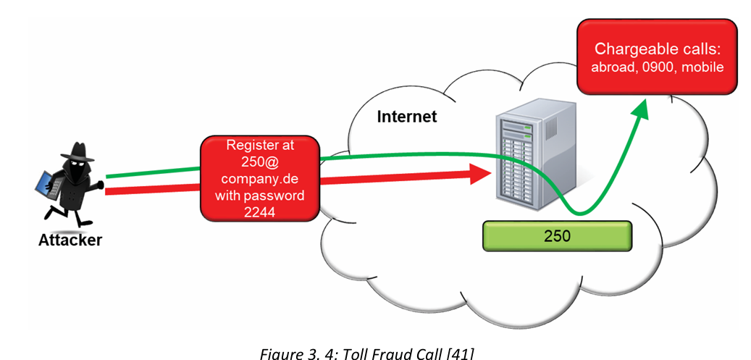


Conceptual SIP Attack Stages
The implemented stages express suspicion. Calls stay on isolated lab routes.
Notes:
This slide retains the original conceptual attack-stage illustration. In the working detector, successful registration after failures is SUSPECTED_COMPROMISE, and a linked INVITE is SUSPECTED_OUTBOUND_ATTEMPT. A valid REGISTER proves credential acceptance. It does not prove theft. The separate CALL_BURST extension counts distinct call attempts. The controlled lab uses a temporary SIPp answer route with no provider billing.

Slide 4

Research Aim and Objectives
To design, build, and evaluate an adaptive multi-stage behavioural progression architecture for early detection of SIP toll fraud.
Identify confirmed authentication failures and target diversity.
Link recovery and outbound attempts by source and account.
Compare native and external lab implementations.
Evaluate frozen ML and independent permission context.
Measure false alerts, warning lead time and runtime behaviour.
Notes:
The aim of this research is to design, build, and evaluate an adaptive multi-stage behavioural progression architecture for early detection of SIP toll fraud.
There are five main objectives.
First, I need to identify early SIP and behavioural indicators before fraud starts. These include messages like OPTIONS, INVITE, REGISTER, and SIP response codes such as 401, 403, and 404.
Second, I need to develop a stage-aware progression model. This means the system should track how an entity, such as an IP address or extension, moves from reconnaissance to authentication attack and then possibly to fraud.
Third, I need to implement the framework in a VoIP lab environment. This is why I created the Asterisk PBX and SIPp traffic generator lab.
Fourth, I plan to apply lightweight machine learning to improve the risk scoring. But before that, I am first building the rule-based stage logic and dataset.
Fifth, I need to evaluate the framework using metrics such as accuracy, false alert rate, time-to-detect, and overhead.
So this research is not only a theoretical proposal. It is moving toward a practical prototype and measurable evaluation.
. It is also about building a prototype and testing whether it works in practical conditions.
The original proposal aimed to improve early detection and risk scoring. The final evidence separates implementation from proving an improvement. Context is a separate policy extension. Autonomous online model adaptation and automatic mitigation remain outside the measured prototype.

Slide 5
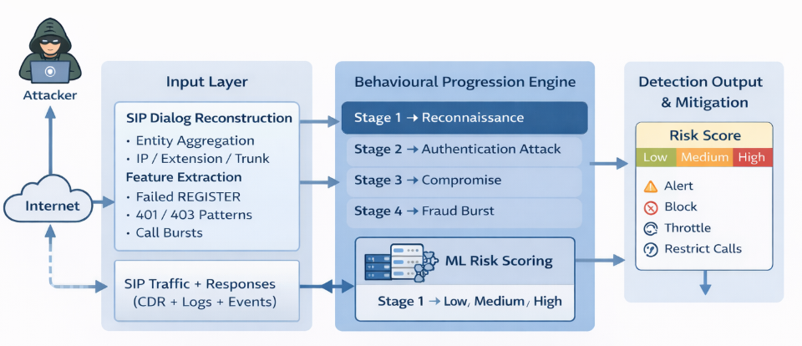
Original Proposed Framework
Working prototype: entity histories, progression evidence and review priority.
Automatic blocking, throttling and call restriction remain future work.
Notes:
This image shows the original proposed architecture. The present implementation covers source/account histories, confirmed failures, progression events, an optional frozen ML review priority, and a separate independent permission layer. The LOW/MEDIUM/HIGH conceptual graphic is not a validated fraud probability. The causal logistic implementation reports LOWER, REVIEW and HIGHER review priority. CDRs independently verify completed lab calls after the event. The prototype does not automatically block, throttle or restrict calls.

Slide 6
Practical Progress After PP1
INFRASTRUCTURE MIGRATION
From two Azure VMs to two physical Raspberry Pis for repeatable SIP tests
Earlier Azure laboratory
Current isolated Raspberry Pi laboratory
Asterisk PBX VM
SIPp traffic-generator VM
Initial OPTIONS / REGISTER / INVITE checks
Astrix-lab · Asterisk 20.6.0 · 172.16.200.81
Sipp-generator · SIPp · 172.16.200.68
PCAP + PJSIP logs + CDR evidence
LAB ISOLATED · NO PSTN
TWO CONTROLLED ACCOUNTS
CONTROLLED SIP TRAFFIC
PP2 now includes progression rules, frozen ML and independent permission evaluation.
PP2 Research progress. Evidence through 12 October 2026.
Notes:
In my first progress presentation I demonstrated the Asterisk and SIPp lab using two Azure virtual machines. Later I migrated the experiment to two Raspberry Pis so I could run repeated controlled tests locally. The SIPp generator uses the address 172.16.200.68, and the Asterisk PBX uses 172.16.200.81. Both were reachable at the latest check. Our tests use only isolated extensions and temporary lab routes; no external paid calls are involved. This slide is about what changed since PP1, not a comparison of Azure and Pi performance.

Slide 7
Experimental Workflow and Evidence
END-TO-END IMPLEMENTATION
1
2
3
4
5
6
SIPp
Generator
Asterisk
PBX
SIP packet
evidence
Causal event
adapter
Rules and
V6 stages
Context and
evaluation
Independent verification
Early-decision boundary
PCAP timestamps, PBX failure logs and answered call records
Each prediction sees only current and earlier packets. Labels enter later.
PP2 Research progress. Evidence through 12 October 2026.
Notes:
The generator sends controlled traffic to Asterisk. A PBX-side capture supplies transaction-matched SIP events in time order. The common evaluator exposes only packets at or before the current event, with an empty CDR view. Auth 10, Auth 5, frozen V6 and V6 plus context receive the same observations. Policy exists before traffic and contains no case ID or role label. Independent PBX failure logs and before/after CDR snapshots validate what occurred. The label enters only after a method returns its prediction. The prior ML experiment remains a separate evidence family. Sources: common_evaluator.py, policy.json, prospective_manifest.json and evaluation_freeze.json.

Slide 8
Detector Evolution: V2 to V6
IMPLEMENTATION ITERATIONS
V2
Initial request/count rules
Simple thresholds
V3
First stage-event replay
Alert gaps exposed
V4
Timing and behaviour refinement
Robustness experiments
V5
Confirmed authentication failures
Avoid raw 401 overcounting
V6
Linked progression stages
Multi-step behaviour tracked
Research iterations add confirmed failures and linked progression. V6 remains frozen.
PP2 Research progress. Evidence through 12 October 2026.
Notes:
I did not build the final detector in one step. I changed the detection logic after finding false alerts and missed scenarios. Early versions largely counted SIP requests. V5 improved the handling of transaction-confirmed authentication failure: one normal 401 digest challenge is not itself a failed password. V6 then linked events into behavioural stages, including reconnaissance, authentication attack, recovery after failed login, and linked outbound activity. These are research iterations, not production releases.

Slide 9
Controlled Lab Scenarios: F01–F12
DEVELOPMENT SET: SIX BENIGN AND SIX SIMULATED ROLES
V3
66.7% F1
V6 CONFUSION MATRIX
6
1
V5
83.3% F1
TP
FP
V6
92.3% F1
5
0
TN
FN
Limitation: false alert in F05 (legitimate password recovery + authorized call).
PP2 Research progress. Evidence through 12 October 2026.
Notes:
I registered twelve controlled scenarios: six benign controls and six simulated attack scenarios. For V6, all six assigned attack scenarios were flagged, but one benign recovery scenario was also flagged. This gave six true positives, one false positive, five true negatives and no false negatives. Precision was 85.7 percent, recall 100 percent, and F1 92.3 percent. V3 and V5 were weaker on this particular small set. The cases are deliberately controlled; these numbers should not be presented as real-world accuracy.
F01 to F12 are development cases. Keep these counts separate from the twelve fresh C-series cases collected on 12 October. The new context comparison does not replace the historical F-series result.

Slide 10
Why Benign Behaviour Can Look Like Fraud
GROUND-TRUTH AND FALSE ALERTS
AUTHORIZED USER
SIMULATED UNAUTHORIZED ROLE
An old password creates confirmed failures
A corrected password permits registration
An authorized call may follow
Controlled wrong-password attempts
A supplied lab credential permits registration
An isolated outbound attempt follows
Matched SIP behaviour can receive the same stage and ML output
New extension: independent account, destination and recovery permissions.
PP2 Research progress. Evidence through 12 October 2026.
Notes:
A key finding is that SIP behaviour alone does not always tell us whether a person has permission. For example, an authorized user may have an old password stored on a phone, generate several real authentication failures and then successfully register. Our isolated simulated-abuse scenarios can deliberately create the same sequence. In the matched pairs H003 versus H007 and H004 versus H008, the SIP evidence produced the same V6 stage output and the same frozen ML decision even though the assigned roles were opposite. Therefore an alert is a signal for investigation, not proof of theft, compromise or toll fraud.
The new experiment now tests independent policy. It reduces one actionable benign recovery alert, but deliberately matched C003 and C011 remain indistinguishable under the same allowed policy. The matrix therefore supplies useful context while preserving an explicit ambiguity boundary.

Slide 11
Historical Dataset and Evidence Validation
LOCAL SCENARIOS + CDR
24
10
34/34
21/21
Development cases
Inspected H cases
PCAP hashes verified
Archived answered CDRs
Evidence recorded per scenario
Important distinction
Manifest + packet capture + auth log + CDR delta + model hash
CDRs corroborate completion. Caller permission requires separate evidence.
PP2 Research progress. Evidence through 12 October 2026.
Notes:
For the local modelling experiment, I collected 24 development scenarios and froze the model before collecting 10 held-out scenarios. All 34 archived runs passed independent SIP packet, authentication-log and call-outcome verification. On 10 October I also recalculated the archive hashes and reconciled the run-local call records: 21 new answered lab CDR rows were found, all with six seconds billable time and isolated test destinations. This verification increases reproducibility but does not transform existing test data into new held-out observations.
These H cases were collected after freezing the original retrospective model, but they have since been inspected. They are no longer a fresh evaluation set. The new C-series cases use a separate prospective protocol and are not pooled with the archive.

Slide 12
Local Machine Learning Results
RETROSPECTIVE H-CASE AUDIT AND FROZEN CAUSAL MODEL
Method | TP | FP | TN | FN | Bal. accuracy
Frozen decision tree | 1 | 0 | 5 | 4 | 60%
V6 any-stage rules | 3 | 2 | 3 | 2 | 60%
V6 answered-stage | 2 | 1 | 4 | 3 | 60%
Fresh causal ML: five matched pairs received the same review priority
B006–B015 assigned role | LOWER | REVIEW | HIGHER
Authorized | 1 | 3 | 1
Simulated unauthorized | 1 | 3 | 1
PP2 Research progress. Evidence through 12 October 2026.
Notes:
The upper table preserves the historical ten H-case retrospective audit. The frozen whole-case decision tree gives TP=1, FP=0, TN=5 and FN=4. These observations have already been inspected. The lower table summarizes the separate fresh causal model evaluation B006 to B015: five matched profiles with opposite assigned roles and thirty answered isolated calls. The model scores only four timing features available at the first eligible successful REGISTER. Each matched pair receives the same LOWER, REVIEW or HIGHER category. A score is review metadata rather than an operational fraud probability. Both rule evidence and the negative intent-discrimination result remain visible. Sources: thesis Section 5.4, frozen causal model and the retained B006–B015 evidence.

Slide 13
Public SIP Dataset: Separate ML Experiment
PUBLISHED INVITE-FLOODING BENCHMARK
1,351,310
4
Train on file 1
Public INVITE message rows
Public CSV files
Evaluate on files 2, 3 and 4
File 2
91.44%
File 3
96.67%
File 4
96.82%
Balanced accuracy measures the two labels fairly; it is not local toll-fraud accuracy.
PP2 Research progress. Evidence through 12 October 2026.
Notes:
I also reviewed eight publications and separately studied an author-linked public dataset containing 1,351,310 SIP INVITE message rows across four files. These are SIP messages, not 1.35 million completed calls. I trained a small decision tree on file 1 using only timing information: the gap from the previous INVITE, the count in the past one second and the count in the past ten seconds. On files 2 to 4, balanced accuracy was 91.44, 96.67 and 96.82 percent. This is a different flooding-classification task on a synthetic published dataset; the figures do not improve or validate the local fraud-intent model.

Slide 14
Live Native vs External Detector Comparison
ASTERISK MODULE AND PYTHON SERVICE
7 / 7
21
5
Declared test cases passed
Answered isolated lab calls
Online stage categories
Stage | Native median | External median
Reconnaissance | 0.085 ms | 628.5 ms
Authentication attack* | 1,016.0 ms | 1,907.2 ms
Recovery + ML review | 4.709 ms | 394.0 ms
Linked outbound attempt | 0.090 ms | 522.1 ms
Third distinct call burst | 0.091 ms | 640.7 ms
*Includes a one-second retry grace; stage timing origins are not identical.
PP2 Research progress. Evidence through 12 October 2026.
Notes:
I compared a passive C-based observer inside Asterisk with an external Python detector fed by SIP events. Seven predeclared live laboratory cases passed packet, authentication-log, CDR and cleanup checks, with 21 answered lab calls. The native and external paths reproduced the same five online stage categories and frozen ML metadata in the declared enabled cases. Native median packet-to-decision delay was lower in this small pilot. The authentication row includes a one-second retry grace, so that delay is not pure processing time. Seven cases are not enough to establish a general production speed guarantee.

Slide 15
Call Setup and Resource Measurements
PERFORMANCE LIMITATIONS
Deployment mode | Case A: median setup | Case B: median setup
Detector OFF | 15.710 ms | 12.900 ms
Native in Asterisk | 60.539 ms | 43.350 ms
External detector | 38.099 ms | 19.613 ms
What was measured
What is not established
Packet-to-decision, call setup, CPU and process memory
Causal overhead, long-term stability or production throughput
PP2 Research progress. Evidence through 12 October 2026.
Notes:
I also measured how the deployments behaved while calls were set up. In the primary live comparison, the two disabled-detector control cases had median setup times of 15.710 and 12.900 milliseconds. Native cases were 60.539 and 43.350 milliseconds, while external cases were 38.099 and 19.613 milliseconds. The whole PBX CPU was about 0.20 to 0.22 percent of one core in primary cases, but Wi-Fi variation, very few repetitions and measurement limits prevent a causal overhead conclusion. Native decisions were faster in the pilot, but we cannot claim zero PBX call-setup overhead.

Slide 16
Fresh REGISTER Controls: 12 October 2026
FOUR SEPARATE CONTROLS WITH INDEPENDENT RESPONSE VERIFICATION
4 / 4 controls verified
No call activity
24 requests with matched PBX responses
Zero CDR delta and no PBX configuration change
Control | REGISTER target pattern | Distinct IDs | Diversity review | Verified
P101 | Configured 1001 repeated | 1 | 0 | PASS
P102 | Configured 1001 and 1002 | 2 | 0 | PASS
P103 | Unused 9001 repeated | 1 | 0 | PASS
P104 | Unused 9001 to 9006 | 6 | 1 | PASS
Original P002 remains incomplete. P102 uses a revised send-only and PCAP path.
PP2 Research progress. Evidence through 12 October 2026.
Notes:
Each new control sends six unauthenticated REGISTER requests. The PBX-side capture independently matches all six responses. P101 targets one configured identity, P102 both configured identities, P103 one unused identity, and P104 six unused identities. Only P104 reaches the five-distinct-target review threshold. These are account-diversity controls, not role-labelled fraud-accuracy cases. No INVITE or CDR change occurred. Original P002 remains a stopped timeout. New P102 verifies six request/response transactions in 8.375 seconds with a revised send-only sender. This does not establish that the old generator receive path is repaired. Source: registration_controls/summary.json and P101–P104 raw captures.

Slide 17
Independent Permission Context
PREDECLARED POLICY AND ONE COMMON EVALUATOR
Account | Allowed source | Allowed destination | Recovery permission
1001 | 172.16.200.68 | 88001 | Two hours. Up to 8 confirmed failures
1002 | 172.16.200.68 | 88002 | No recovery permission observed
Same causal events for Auth 10, Auth 5, frozen V6 and V6 + context
Policy contains no case IDs or role labels. Missing permission keeps review.
PP2 Research progress. Evidence through 12 October 2026.
Notes:
The administrator policy froze before fresh traffic. Both accounts share the generator IP and may register. 1001 may call 88001, and 1002 may call 88002. One independent recovery record covers 1001 from that source for two hours with at most eight confirmed failures. 1002 has no observed recovery record. The same rules apply to benign and simulated roles. The evaluator retains every raw V6 stage while changing its actionable disposition. Auth 10 means ten confirmed failures in sixty seconds per source/account. Auth 5 is a predeclared sensitivity comparator. Missing identity or recovery evidence remains unknown. Sources: policy.json, evaluation_freeze.json, prospective_manifest.json and common_evaluator.py. Policy reflects emulated lab permissions. Both temporary destinations still route to an isolated SIPp UAS for validation.

Slide 18
Fresh Controlled Comparison
C001–C012: SIX BENIGN AND SIX SIMULATED ROLES
12 / 12 verified cases 50 confirmed password failures 9 answered isolated calls
Method | TP | FP | TN | FN | Balanced accuracy | False-alert rate
Auth 10 | 1 | 0 | 6 | 5 | 58.3% | 0.0%
Auth 5 | 5 | 2 | 4 | 1 | 75.0% | 33.3%
V6 | 5 | 2 | 4 | 1 | 75.0% | 33.3%
V6 + context | 5 | 1 | 5 | 1 | 83.3% | 16.7%
Context removes one false alert. V6 and context each miss one different case.
PP2 Research progress. Evidence through 12 October 2026.
Notes:
All twelve cases pass the declared packet, authentication-log, CDR-delta and cleanup gates. Six carry the assigned benign role and six the simulated-abuse role. No case is replaced or excluded. Auth 10 has 1/0/6/5, Auth 5 has 5/2/4/1, V6 has 5/2/4/1, and V6 with context has 5/1/5/1 in TP/FP/TN/FN order. Context balanced accuracy rises from 75.0 to 83.3 percent by correctly reviewing one additional benign case. Its precision, recall and F1 are each 0.833 on this set. C004 remains a false alert because recovery permission is unavailable. V6 misses C009, while context misses allowed-policy C011. These are twelve constructed role-labelled lab cases. The value is not a representative operational fraud-accuracy estimate or an ML improvement. Sources: final_results.json, per_case_metrics.csv and runs/fresh/C001–C012. All frozen predictions reproduce without network access.

Slide 19
Early-Warning Coverage
FIVE SIMULATED ROLE CALL CASES. CAUSAL REPLAY EVENT TIME
Median positive
lead time
Method | Seconds
Auth 10 | No warning
Auth 5 | 7.972
V6 | 2.989
V6 + context | 2.995
Lower false-alert count comes with lower coverage before the first INVITE.
PP2 Research progress. Evidence through 12 October 2026.
Notes:
The fixed denominator is five simulated-role cases that attempt calls: C007, C008, C009, C011 and C012. A pre-call warning must occur strictly before the first generator INVITE. Auth 5 and V6 each warn in four of five. Their median positive leads are 7.972 and 2.989 seconds. Context warns in two of five with median positive lead 2.995 seconds, detects C007 and C009 at their first INVITE with zero lead, and misses C011. Auth 10 warns in none of these five. Misses remain in the denominator. Positive-lead medians describe only cases that warn early. All of these are causal replay event-clock results. The new context layer has no measured live notification latency. Sources: final_results.json, per_case_metrics.csv and timestamped_stage_progression.csv.

Slide 20
How Context Changes a Decision
RAW V6 EVIDENCE REMAINS AVAILABLE FOR REVIEW
Case | Policy evidence and assigned role | V6 | Context outcome
C003 | Benign recovery Allowed account, route and recovery | Alert | Authorized recovery review
C004 | Benign recovery Recovery permission unavailable | Alert | Review retained. False alert
C009 | Simulated direct call Destination outside allowlist | No alert | Violation at first INVITE
C011 | Simulated role Same permissions as C003 | Alert | Allowed recovery. Missed role
C003 and C011 show the remaining ambiguity when policy conditions match.
PP2 Research progress. Evidence through 12 October 2026.
Notes:
C003 demonstrates the false-alert reduction: a predeclared permission covers recovery and its allowed destination, so raw V6 evidence remains visible while the contextual disposition is authorized recovery review. C004 has no observed recovery permission and keeps actionable review. C009 has no failed-authentication precursor, so V6 emits no qualifying alert. The permission layer detects its forbidden destination at the first INVITE. C011 deliberately uses the same allowed account, destination and recovery record as benign C003. It therefore receives the same contextual decision despite its opposite assigned role. The system cannot identify hidden human intent from identical observed conditions. Sources: policy_decision_report.csv and the case evaluation.json files for C003, C004, C009 and C011.

Slide 21
Research Objectives: Current Evidence
PROGRESS AGAINST THE PROPOSAL
O1
Early SIP indicators
Confirmed failures, target diversity and recovery events
O2
Stage-aware progression
V6 and context evaluated on twelve fresh cases
O3
Internal/external deployment
Five online stages compared in both deployment paths
O4
Lightweight ML refinement
Causal ML evaluated. Intent improvement remains unproven
O5
Detection + runtime evaluation
Common metrics, warning leads and hash reproduction complete
PP2 Research progress. Evidence through 12 October 2026.
Notes:
I completed the controlled prototype work and report each objective at the scope of its evidence. Confirmed authentication failures and distinct targets are implemented. V6 and independent permission context are compared on twelve fresh cases. Native and external paths have a separate five-stage pilot. Frozen ML has a matched-profile evaluation without demonstrated intent improvement. Common confusion counts, early-warning leads and deterministic reproduction are complete. These findings do not establish general production fraud detection, autonomous adaptation, causal overhead or mitigation safety.

Slide 22
Scope and Next Validation
CONTROLLED PROTOTYPE COMPLETE. BROADER VALIDATION REMAINS
01
Live context delivery
Measure delivery latency for the new permission layer
02
Broader legitimate traffic
More accounts behind NAT and concurrent mixed sessions
03
Deployment stability
Repeat across days, traffic loads and recovery conditions
04
Thesis finalization
Substantive chapter expansion and supervisor review
PP2 Research progress. Evidence through 12 October 2026.
Notes:
The implemented results are complete at the declared controlled-laboratory scope. Larger NAT groups, concurrent legitimate and simulated sessions, production permission records, longer observation periods and repeated load/stability testing would strengthen external validity. The new policy layer still requires live delivery measurement. Automatic mitigation needs a separate disruption and safety evaluation. For the present submission, the available thesis draft remains below the institutional 20,000–30,000-word range. Substantive chapter expansion, the actual similarity check, supervisor review and PP2 rehearsal remain manuscript and human tasks.

Slide 23
PP2 Research Contribution
MAIN RESEARCH CONTRIBUTION TO DATE
Implemented prototype
Measured evidence
Two-Pi lab and V2–V6 progression
Native and external observers
Independent permissions and common evaluator
Historical and causal ML evaluations
Separate 21-call deployment pilot
12 fresh cases and 4 REGISTER controls
PP2 Research progress. Evidence through 12 October 2026.
Notes:
The contribution is an auditable progression prototype with a demonstrated permission-conditioned review extension. The lab verifies protocol activity independently and preserves source, policy and result hashes. Context removes one false alert on the twelve fresh cases, while reducing warning coverage before the first INVITE. The paired allowed-policy case exposes a reproducible ambiguity boundary. A negative intent-discrimination result is part of the evaluated research finding. Earlier development, retrospective ML, causal ML, public flooding and deployment results retain separate denominators. Autonomous adaptation, production accuracy and automatic mitigation remain outside the measured contribution.

Slide 24
Thank You
Questions and Discussion
Notes:
Thank you for reviewing my second research progress presentation. The prototype and controlled evidence are available, including archived packet captures, Asterisk logs, isolated call records and ML checkpoints. I welcome feedback on independent permission context, the fresh held-out evaluation plan and the scope of the remaining research before final thesis submission.

